Slide 1
Chapter-1
Accounting in Action

Slide 2
Identify the activities and users associated with accounting.
Accounting consists of three basic activities—it
  identifies,
  records, and
  communicates
  the economic events of an organization to interested users.

Slide 3
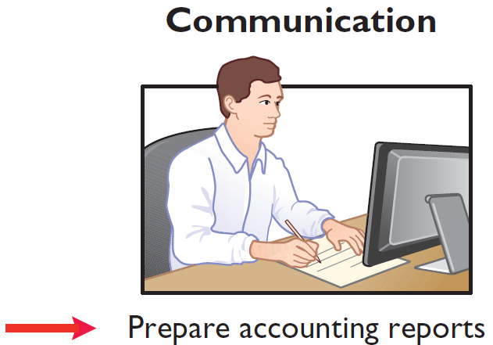
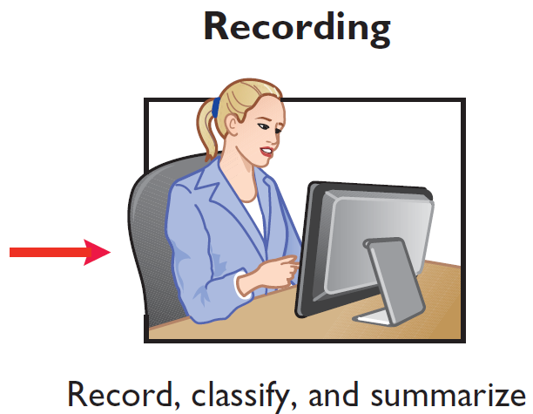
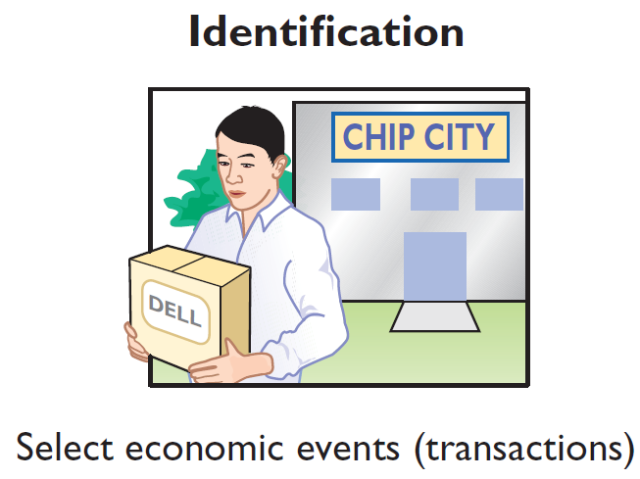
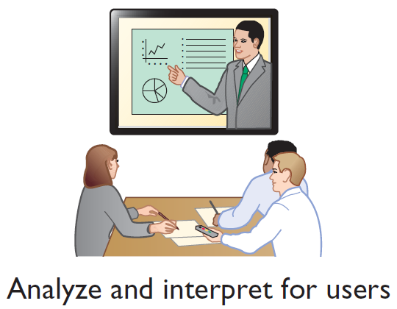
Three Activities
Illustration 1-1
The activities of the accounting process
The accounting process includes
the bookkeeping function.

Slide 4
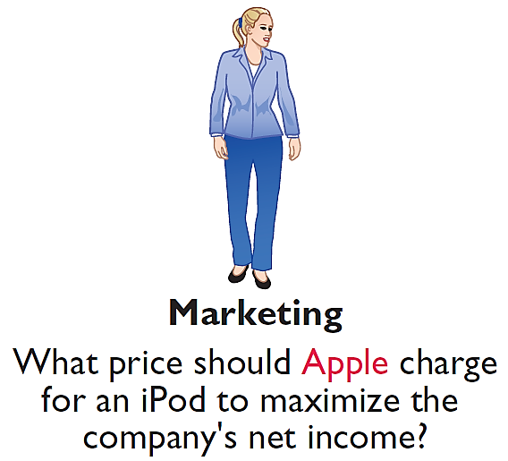
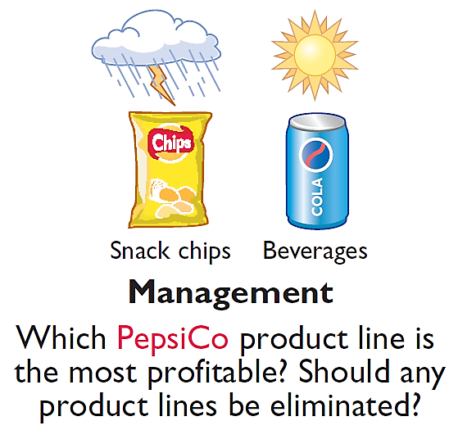
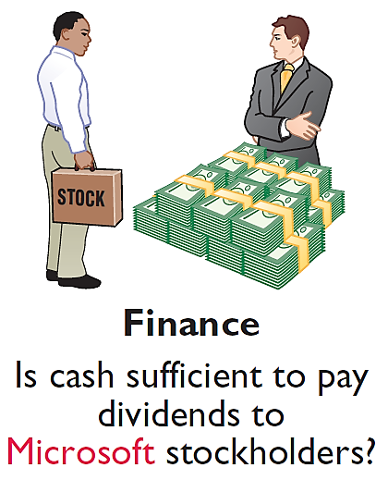

Who Uses Accounting Data
INTERNAL USERS
Illustration 1-2
Questions that internal users ask

Slide 5
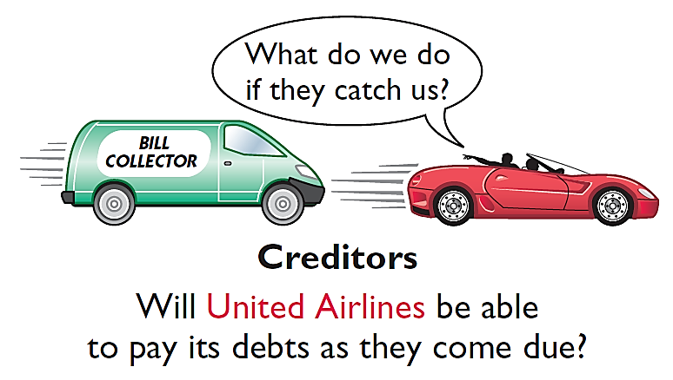

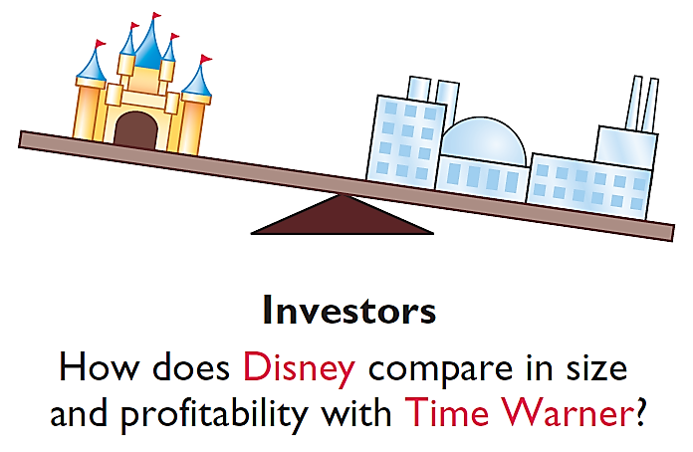
Who Uses Accounting Data
EXTERNAL USERS
Illustration 1-3
Questions that external users ask

Slide 6
Generally Accepted Accounting Principles
Financial Statements
  Balance Sheet
  Income Statement
  Statement of Owner's Equity
  Statement of Cash Flows
  Note Disclosure
Various users need financial information
The accounting profession has developed standards that are generally accepted and universally practiced.
Generally Accepted Accounting Principles (GAAP)

Slide 7
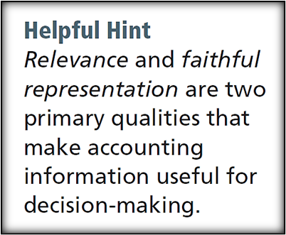
Measurement Principles
HISTORICAL COST PRINCIPLE (or cost principle) dictates that companies record assets at their cost.
FAIR VALUE PRINCIPLE states that assets and liabilities should be reported at fair value (the price received to sell an asset or settle a liability).
Selection of which principle to follow generally relates to trade-offs between relevance and faithful representation.

Slide 8

Assumptions
MONETARY UNIT ASSUMPTION requires that companies include in the accounting records only transaction data that can be expressed in terms of money.
ECONOMIC ENTITY ASSUMPTION requires that activities of the entity be kept separate and distinct from the activities of its owner and all other economic entities.
  Proprietorship
  Partnership
  Corporation
Forms of Business Ownership

Slide 9



Forms of Business Ownership
Proprietorship
Partnership
Corporation
Owned by one person
Owner is often manager/operator
Owner receives any profits, suffers any losses, and is personally liable for all debts
Owned by two or more persons
Often retail and service-type businesses
Generally unlimited personal liability
Partnership agreement
Ownership divided into shares of stock
Separate legal entity organized under state corporation law
Limited liability

Slide 10
State the accounting equation, and define its components.
Assets
Liabilities
Owner's Equity
=
+
Basic Accounting Equation
Provides the underlying framework for recording and summarizing economic events.
Assets are claimed by either creditors or owners.
If a business is liquidated, claims of creditors must be paid before ownership claims.

Slide 11
Basic Accounting Equation
Assets
Liabilities
Owner's Equity
=
+
Assets
  Resources a business owns.
  Provide future services or benefits.
  Cash, Supplies, Equipment, etc.

Slide 12
Basic Accounting Equation
Assets
Liabilities
Owner's Equity
=
+
Liabilities
  Claims against assets (debts and obligations).
  Creditors (party to whom money is owed).
  Accounts Payable, Notes Payable, Salaries and Wages Payable, etc.

Slide 13
Basic Accounting Equation
Assets
Liabilities
Owner's Equity
=
+
Owner's Equity
  Ownership claim on total assets.
  Referred to as residual equity.
  Investment by owners and revenues (+)
  Drawings and expenses (-).

Slide 14
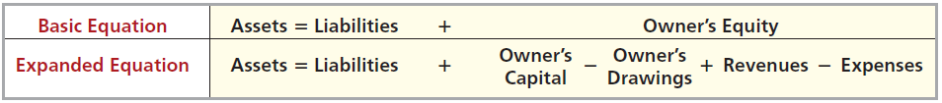
Owner’s Equity
Illustration 1-6
Expanded accounting equation
Increases in Owner’s Equity
Investments by owner are the assets the owner puts into the business.
Revenues result from business activities entered into for the purpose of earning income.
  Common sources of revenue are: sales, fees, services, commissions, interest, dividends, royalties, and rent.

Slide 15
Owner’s Equity
Illustration 1-6
Expanded accounting equation
Decreases in Owner’s Equity
Drawings An owner may withdraw cash or other assets for personal use.
Expenses are the cost of assets consumed or services used in the process of earning revenue.
  Common expenses are: salaries expense, rent expense, utilities expense, tax expense, etc.

Slide 16
Analyze the effects of business transactions on the accounting equation.
Transactions are a business’s economic events recorded by accountants.
  May be external or internal.
  Not all activities represent transactions.
  Each transaction has a dual effect on the accounting equation.

Slide 17
Tabular Analysis
Transactions made by Virmari & Co., a public accounting firm, for the month of August are shown below. Prepare a tabular analysis which shows the effects of these transactions on the expanded accounting equation, similar to that shown in Illustration 1-8.
The owner invested $25,000 cash in the business.
The company purchased $7,000 of office equipment on credit.
The company received $8,000 cash in exchange for services performed.
The company paid $850 for this month’s rent.
The owner withdrew $1,000 cash for personal use.

Slide 18
Tabular Analysis
The owner invested $25,000 cash in the business.
Assets = Liabilities + Owner's Equity
Trans-
action
Cash
+
Equipment
=
Accounts
Payable
+
Owner's Capital
+
Owner's Drawings
+
Rev.
-
Exp.
1. +25,000 +25,000
2. +7,000 +7,000
3. +8,000 +8,000
4. -850 -850
5. -1,000 -1,000
+
=
+
+
-
-
$31,150 $7,000 $7,000 $25,000 $8,000 $850 $1,000
$18,050
$18,050

Slide 19
Tabular Analysis
The company purchased $7,000 of office equipment on credit.
Assets = Liabilities + Owner's Equity
Trans-
action
Cash
+
Equipment
=
Accounts
Payable
+
Owner's Capital
+
Owner's Drawings
+
Rev.
-
Exp.
1. +25,000 +25,000
2. +7,000 +7,000
3. +8,000 +8,000
4. -850 -850
5. -1,000 -1,000
+
=
+
+
-
-
$31,150 $7,000 $7,000 $25,000 $8,000 $850 $1,000
$18,050
$18,050

Slide 20
Tabular Analysis
The company received $8,000 cash in exchange for services performed.
Assets = Liabilities + Owner's Equity
Trans-
action
Cash
+
Equipment
=
Accounts
Payable
+
Owner's Capital
+
Owner's Drawings
+
Rev.
-
Exp.
1. +25,000 +25,000
2. +7,000 +7,000
3. +8,000 +8,000
4. -850 -850
5. -1,000 -1,000
+
=
+
+
-
-
$31,150 $7,000 $7,000 $25,000 $8,000 $850 $1,000
$18,050
$18,050

Slide 21
Tabular Analysis
The company paid $850 for this month’s rent.
Assets = Liabilities + Owner's Equity
Trans-
action
Cash
+
Equipment
=
Accounts
Payable
+
Owner's Capital
+
Owner's Drawings
+
Rev.
-
Exp.
1. +25,000 +25,000
2. +7,000 +7,000
3. +8,000 +8,000
4. -850 -850
5. -1,000 -1,000
+
=
+
+
-
-
$31,150 $7,000 $7,000 $25,000 $8,000 $850 $1,000
$18,050
$18,050

Slide 22
Tabular Analysis
The owner withdrew $1,000 cash for personal use.
Assets = Liabilities + Owner's Equity
Trans-
action
Cash
+
Equipment
=
Accounts
Payable
+
Owner's Capital
+
Owner's Drawings
+
Rev.
-
Exp.
1. +25,000 +25,000
2. +7,000 +7,000
3. +8,000 +8,000
4. -850 -850
5. -1,000 -1,000
+
=
+
+
+
-
$31,150 $7,000 $7,000 $25,000 $1,000 $8,000 $850
$38,150
$38,150

Slide 23
Describe the four financial statements and how they are prepared.
Companies prepare four financial statements :
Income Statement
Owner’s Equity Statement
Balance Sheet
Statement of Cash Flows

Slide 24
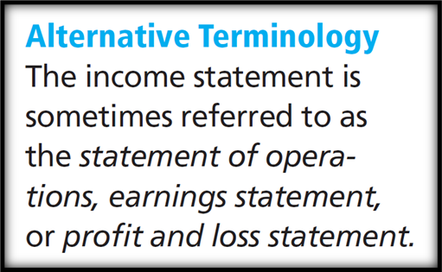
Income Statement
Reports the revenues and expenses for a specific period of time.
Lists revenues first, followed by expenses.
Shows net income (or net loss).
Does not include investment and withdrawal transactions between the owner and the business in measuring net income.

Slide 25
Owner’s Equity Statement
Reports the changes in owner’s equity for a specific period of time.
The time period is the same as that covered by the income statement.

Slide 26
Balance Sheet
Reports the assets, liabilities, and owner's equity at a specific date.
Lists assets at the top, followed by liabilities and owner’s equity.
Total assets must equal total liabilities and owner's equity.
Is a snapshot of the company’s financial condition at a specific moment in time (usually the month-end or year-end).

Slide 27
Statement of Cash Flows
Information on the cash receipts and payments for a specific period of time.
Answers the following:
  Where did cash come from?
  What was cash used for?
  What was the change in the
  cash balance?

Slide 28

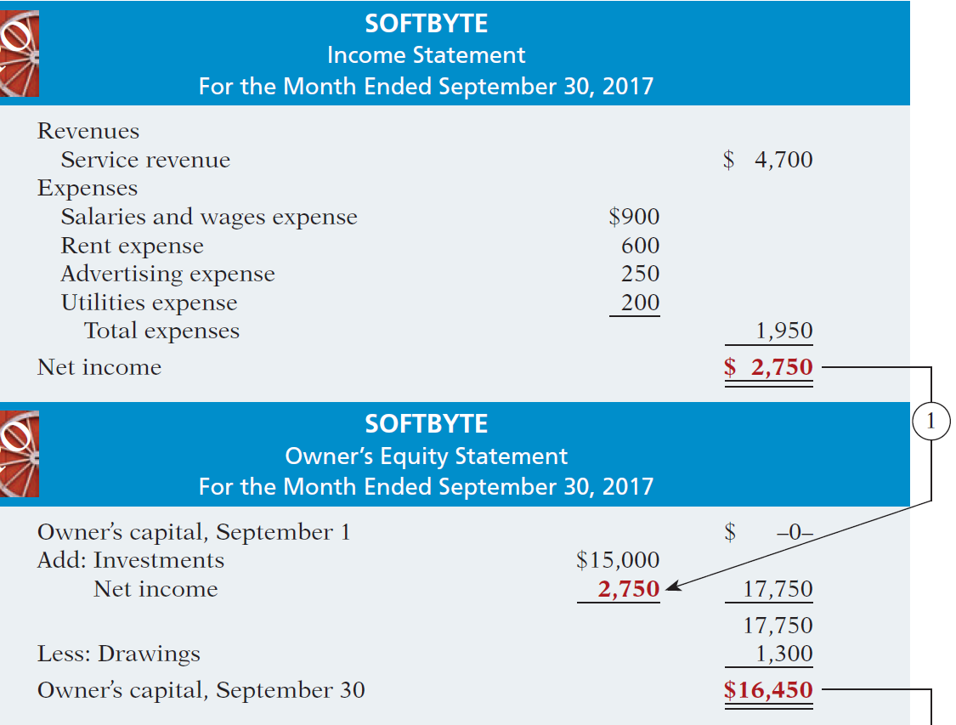
Net income is needed to determine the ending balance in owner’s equity.
Financial Statements
SOFTBYTE
Income Statement
For the Month Ended September 30, 2017
Illustration 1-9
Financial statements and
their interrelationships
SOFTBYTE
Owner’s Equity Statement
For the Month Ended September 30, 2017

Slide 29
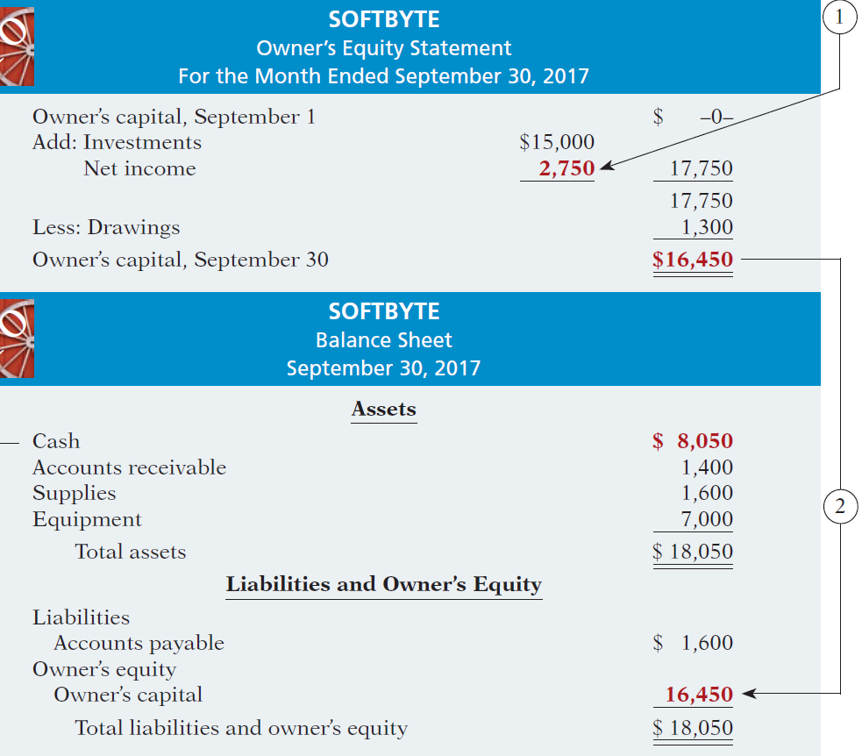

SOFTBYTE
Owner’s Equity Statement
For the Month Ended September 30, 2017
The ending balance in owner’s equity is needed in preparing the balance sheet.
Illustration 1-9
SOFTBYTE
Balance Sheet
September 30, 2017
Illustration 1-9
Financial statements and their interrelationships

Slide 30
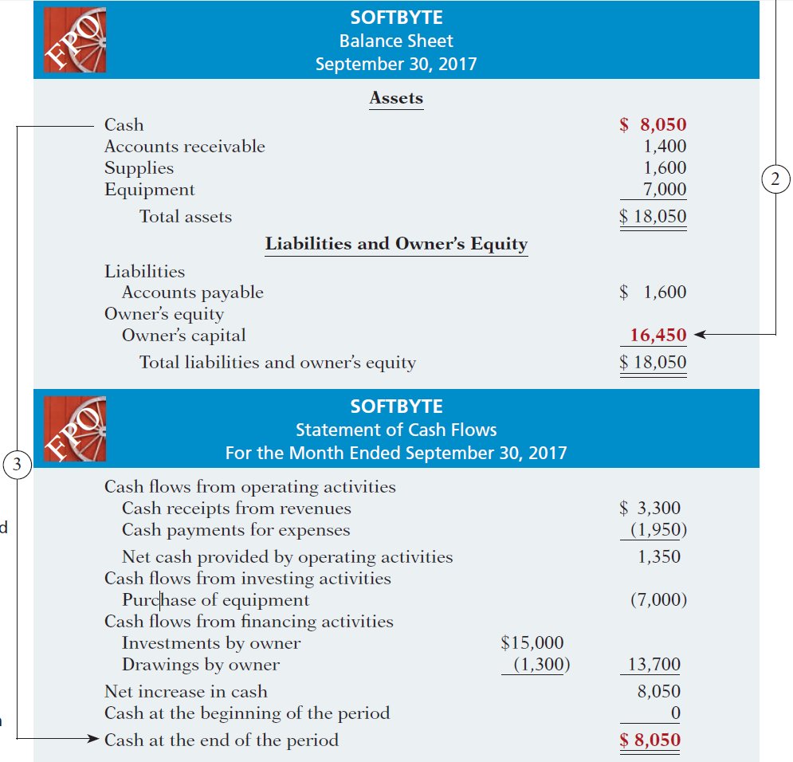

Financial Statements
SOFTBYTE
Balance Sheet
September 30, 2017
Balance sheet and income statement are needed to prepare statement of cash flows.
SOFTBYTE
Statement of Cash Flows
For the Month Ended September 30, 2017
Illustration 1-9
Financial statements and their interrelationships

Slide 31
Problem 1
Gordon Beckham started his own delivery service, Beckham Deliveries, on June 1, 2012.
The following transactions occurred during the month of June.
June 1. Gordon invested $10,000 cash in the business.
2. Purchased a used van for deliveries for $12,000. Gordon paid $2,000 cash and signed a note payable for the remaining balance.
3. Paid $500 for office rent for the month.
5. Performed $4,400 of services on account.
9. Withdrew $200 cash for personal use.
12. Purchased supplies for $150 on account.
15. Received a cash payment of $1,250 for services provided on June 5.
17. Purchased gasoline for $200 on account.
20. Received a cash payment of $1,300 for services provided.

Slide 32
Problem-1 Continue
23. Made a cash payment of $600 on the note payable.
26. Paid $250 for utilities.
29. Paid for the gasoline purchased on account on June 17.
30. Paid $1,000 for employee salaries.
Instructions
Show the effects of the previous transactions on the accounting equation
Prepare an income statement, an owner’s equity statement, and a balance sheet

Slide 33
Problem-2
Juanita Pierre opened a law office, on July 1, 2012. On July 31, the balance sheet showed Cash $5,000, Accounts Receivable $1,500, Supplies $500, Equipment $6,000, Accounts Payable $4,200, and Owner’s Capital $8,800. During August, the following transactions occurred.
1. Collected $1,200 of accounts receivable.
2. Paid $2,800 cash on accounts payable.
3. Earned revenue of $7,500 of which $3,000 is collected in cash and the balance is due in September.
4. Purchased additional office equipment for $2,000, paying $400 in cash and the balance on account.
5. Paid salaries $2,500, rent for August $900, and advertising expenses $400.
6. Withdrew $700 in cash for personal use.

Slide 34
Problem- 2 Continue
7. Received $2,000 from Standard Federal Bank—money borrowed on a note payable.
8. Incurred utility expenses for month on account $270.
Instructions
Prepare a tabular analysis of the August transactions beginning with July 31 balances.

